Slide 1

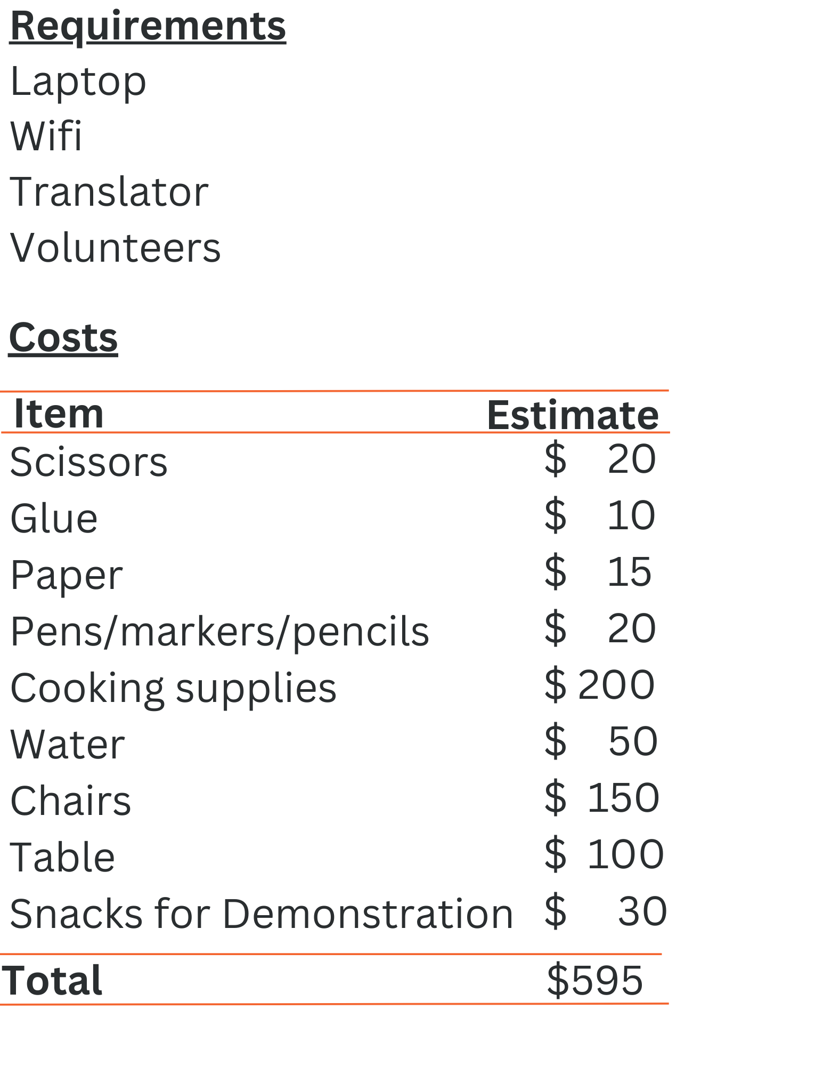

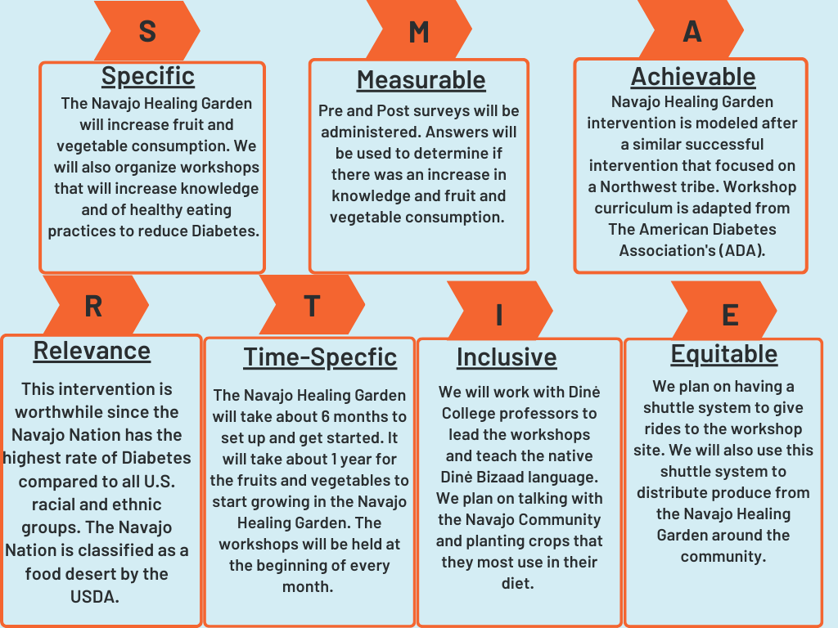
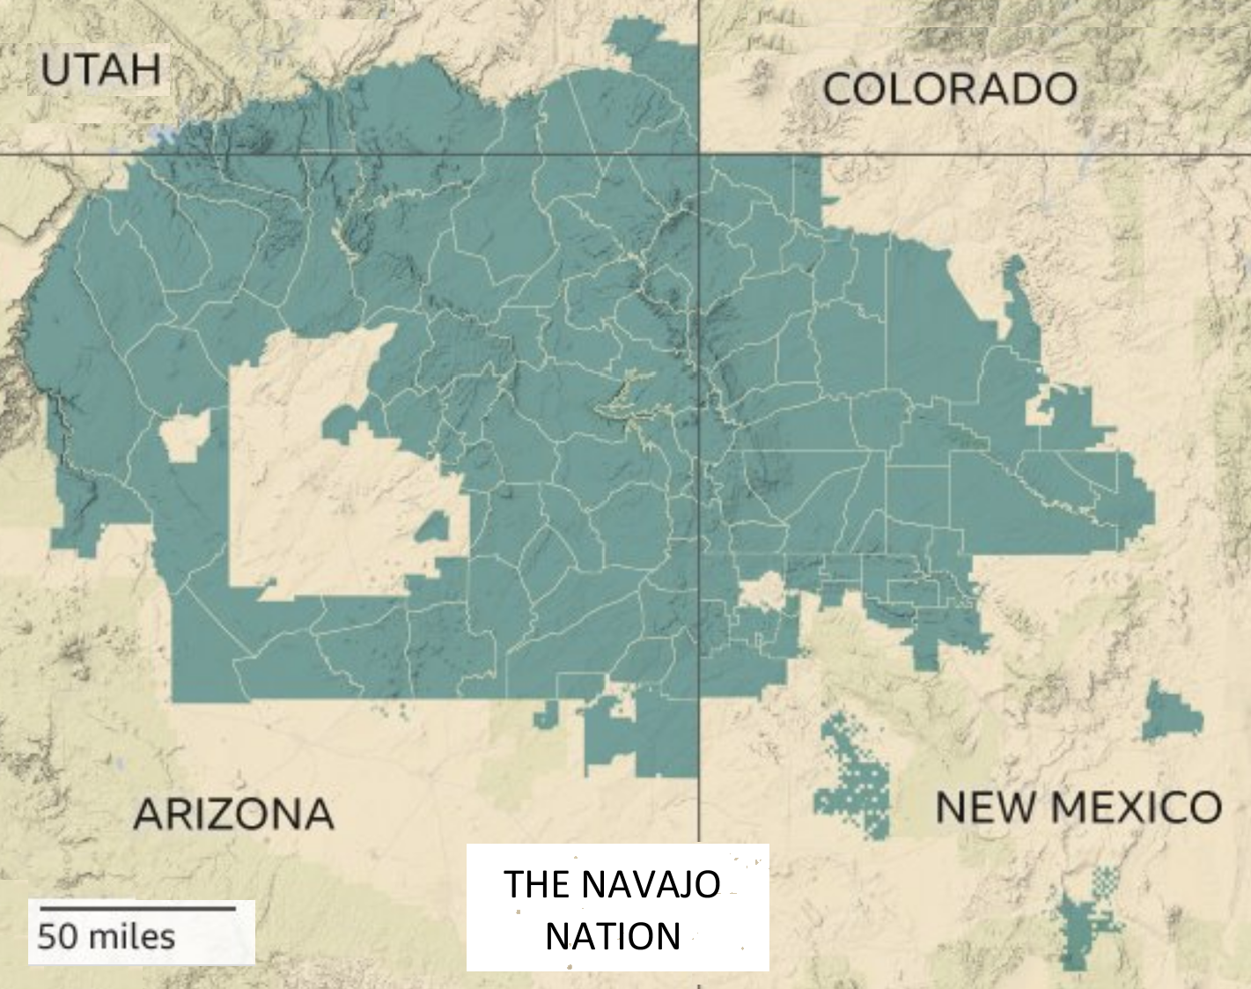
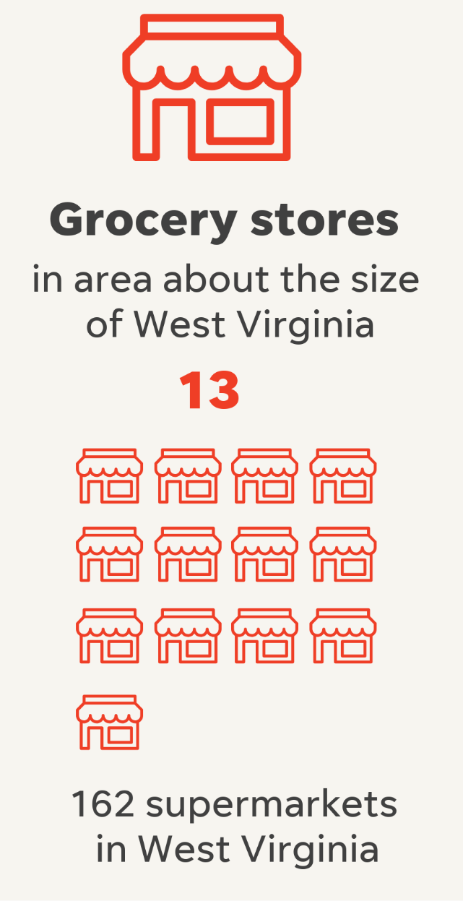
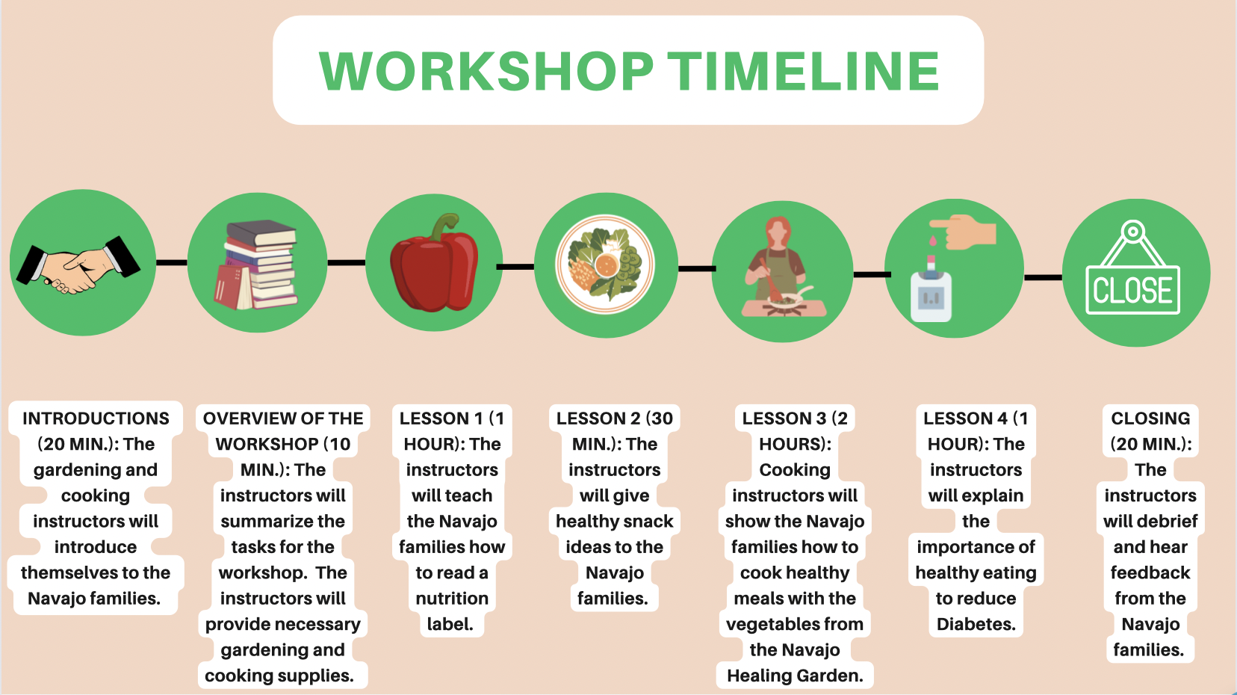
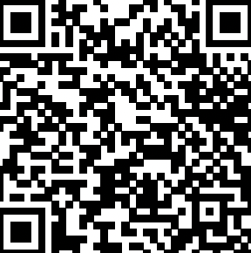
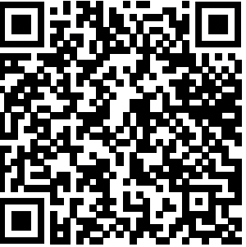
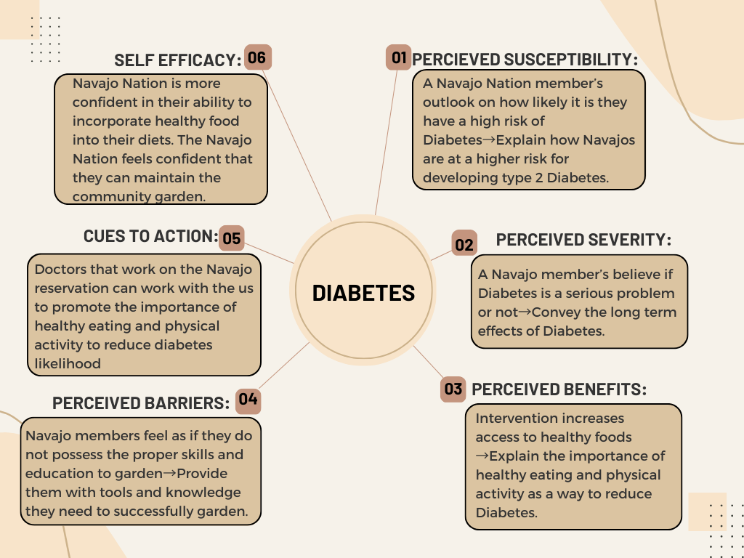
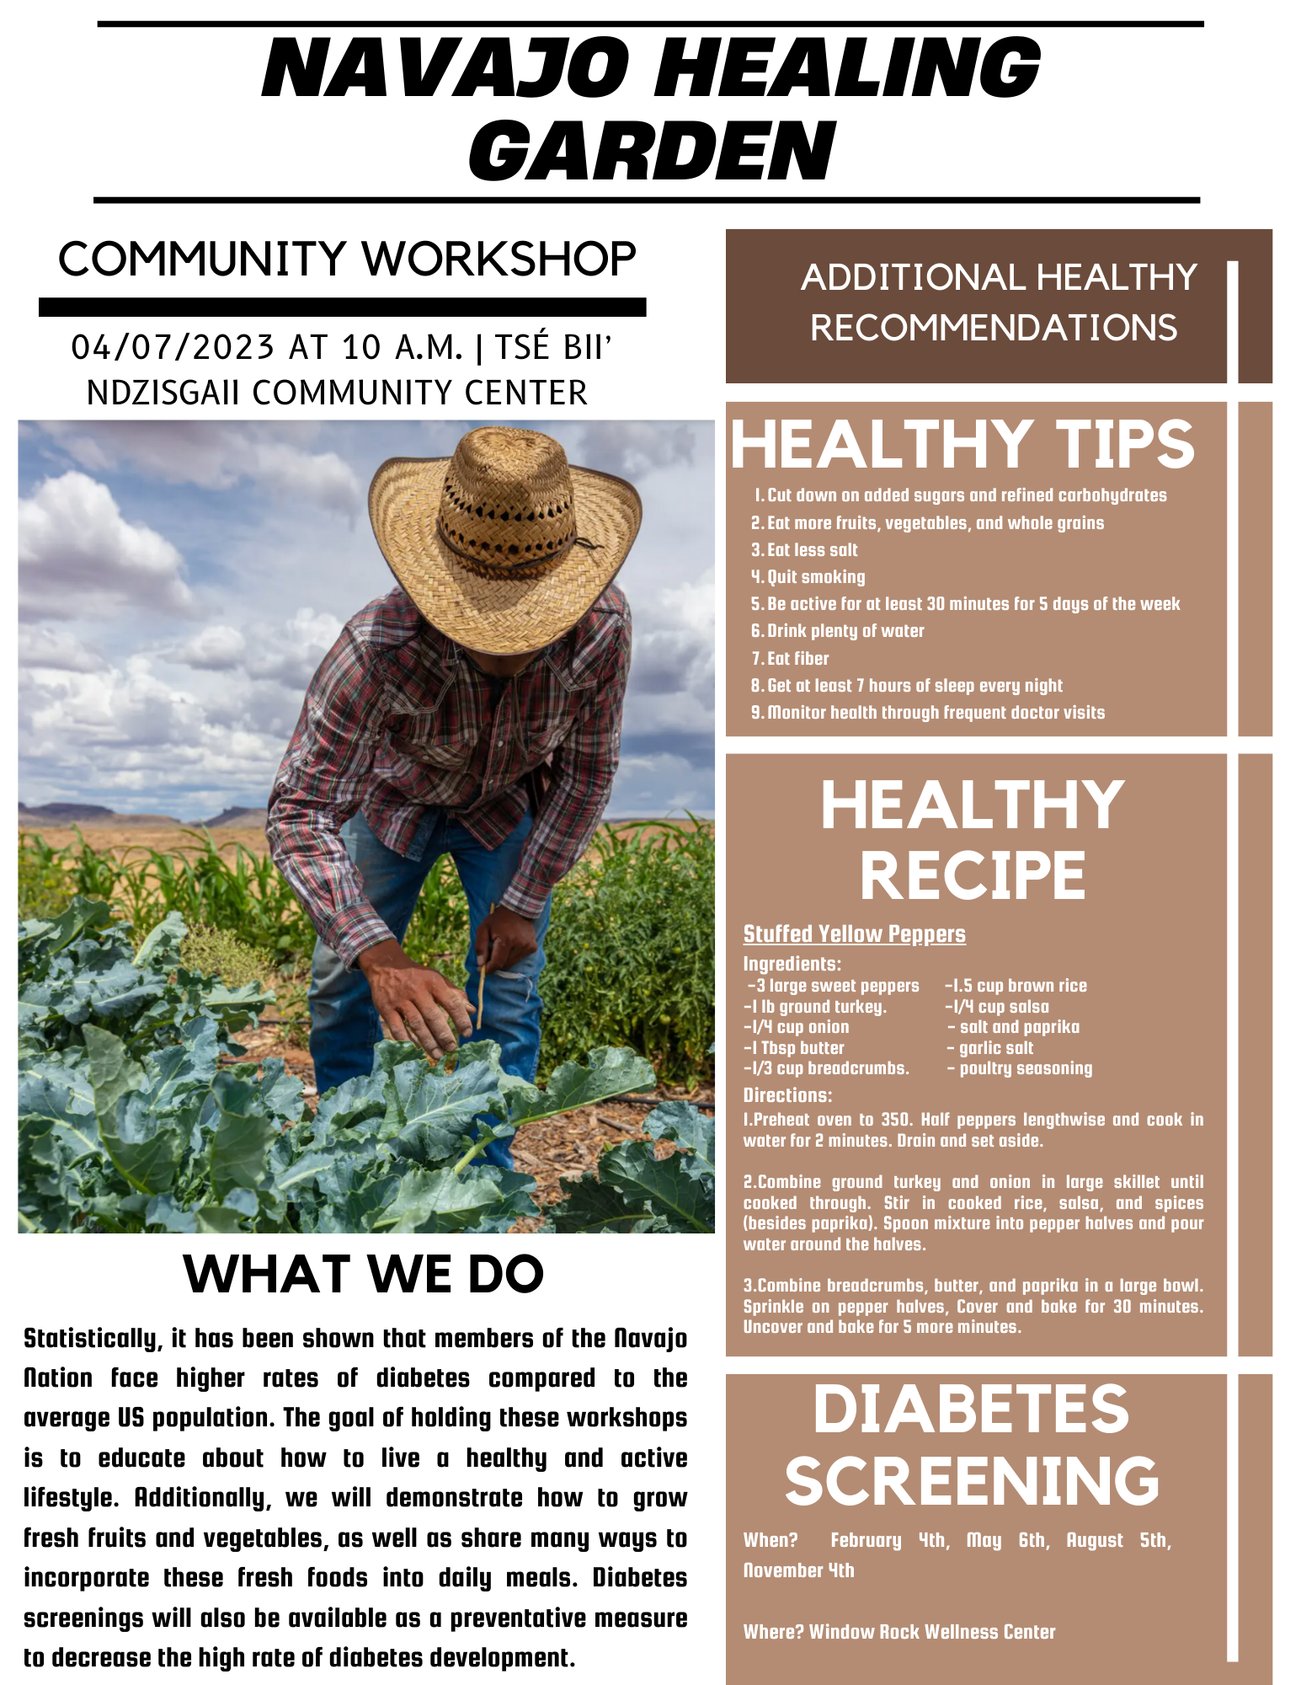
Reducing Diabetes Prevalence Within the Navajo Nation Using the Navajo Healing Garden Intervention
Inara Jiwani¹, Ana Solorzano², Arham Salman³, Alexi Richardson⁴, Leticia Alicea⁵
¹School of Human Ecology, College of Natural Sciences, The University of Texas
Navajo Nation Background
Prototype 1: Workshop
SMART(IE) GOALS⁶
The Navajo Nation resides in Northeastern Arizona, Northwestern New Mexico, and Southeastern Utah. The Navajo Nation has the highest rate of Diabetes of all U.S. racial and ethnic groups. It is estimated that 100,000 Navajo adults currently live with Type 2 Diabetes, a considerable portion of the Navajo Nation.¹ The Navajo reservation has been classified as a food desert by the USDA, as there are only 13 grocery stores that are supposed to support over 200,000 Navajo residents and are scattered across 27,000 square miles of land.² More than 75% of households on the Navajo reservation experience some type of food insecurity. Constant consumption of unhealthy foods can lead to chronic health conditions in the future such as obesity and diabetes. Upon speaking with Miss. Navajo Nation, she explained it is extremely important to “bring resources closer”. This is exactly what we hope to accomplish with our intervention: The Navajo Healing Garden.
Workshop 1 Workplan³:
Health Belief Model
Report
Prototype 2: Monthly Newsletter ^{4, 5}
References
Lombard K, Forster-Cox S, Smeal D, O'Neill MK. Diabetes on the Navajo Nation: What role can gardening and agriculture extension play to reduce it? Rural and Remote Health - Celebrating 20 years of international publishing. https://www.rrh.org.au/journal/article/640. Published October 16, 2006. Accessed March 26, 2023.
Kreider M. 13 grocery stores: The Navajo Nation is a food desert. Planet Forward. https://planetforward.org/story/13-grocery-stores-the-navajo-nation-is-a-food-desert/. Published March 19, 2023. Accessed April 9, 2023.
What can I eat? (WCIE) healthy choices for American Indians and Alaska natives (AI/ANS) with T2D. What Can I Eat? (WCIE) Healthy Choices for American Indians and Alaska Natives (AI/ANs) with T2D | American Diabetes Association. https://professional.diabetes.org/content-page/what-can-i-eat-wcie-healthy-choices-american-indians-and-alaska-natives-aians-t2d. Accessed April 9, 2023.
Stuffed yellow peppers. EatingWell. https://www.eatingwell.com/recipe/265272/stuffed-yellow-peppers/. Published July 10, 2019. Accessed April 9, 2023.
Nierenberg A. For the Navajo Nation, a fight for better food gains new urgency. The New York Times. https://www.nytimes.com/2020/08/03/dining/navajo-nation-food-coronavirus.html. Published August 3, 2020. Accessed April 9, 2023.
Armstrong DL. A Community Diabetes Education and Gardening Project to Improve Diabetes Care in a Northwest American Indian Tribe. The Diabetes Educator. 2000;26(1):113-120. doi:10.1177/014572170002600112

